Slide 1
Architectur
Notes:
So what is .NET?

Slide 2
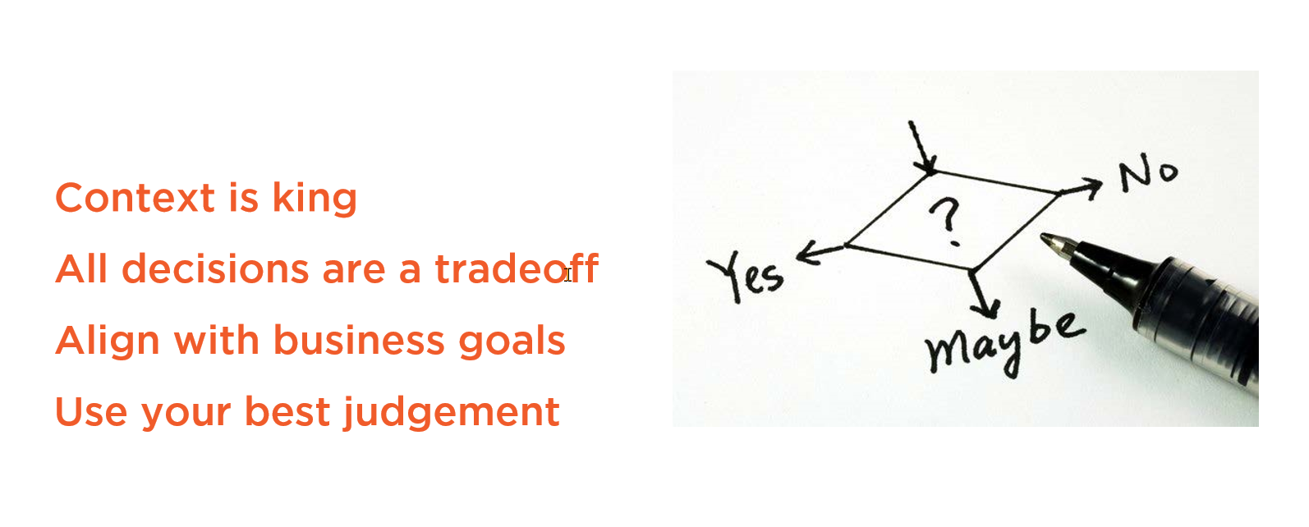
Decisions, Decisions, Decisions

Slide 3
Clean Architecture with ASP.NET Core 3.0 - Jason Taylor - NDC Sydney 2019
https://www.youtube.com/watch?v=5OtUm1BLmG0
Clean Architecture: Patterns, Practices, and Principles by Matthew Renze
https://app.pluralsight.com/library/courses/clean-architecture-patterns-practices-principles/table-of-contents

Slide 4
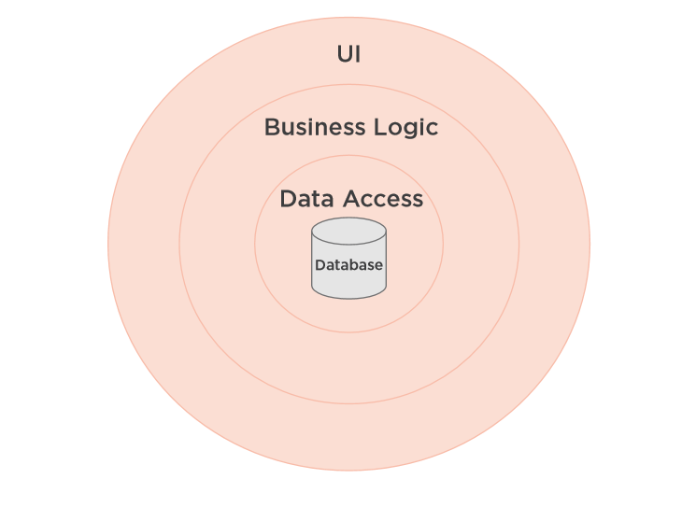
Classic Three-layer Database-centric Architecture

Slide 5
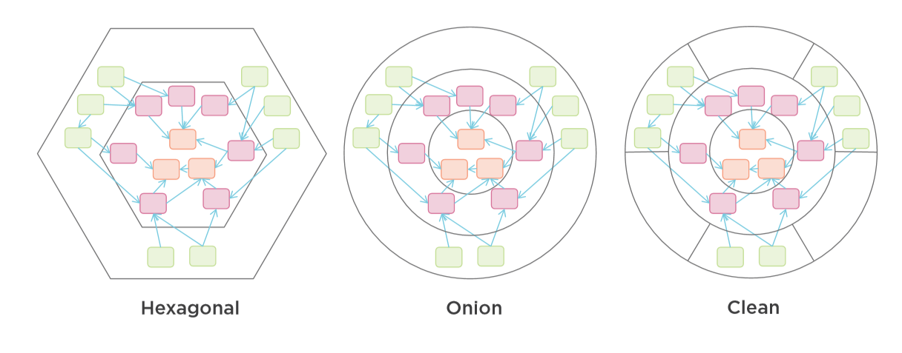
Common Architectures

Slide 6
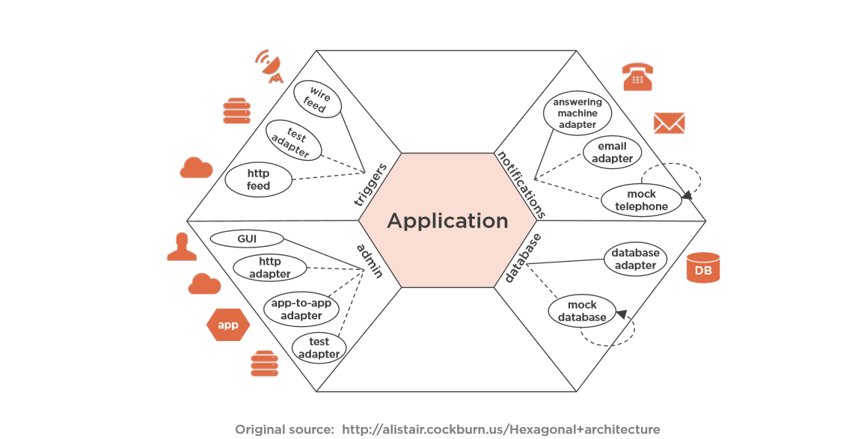
Hexagonal Architecture = Port and Adapters

Slide 7
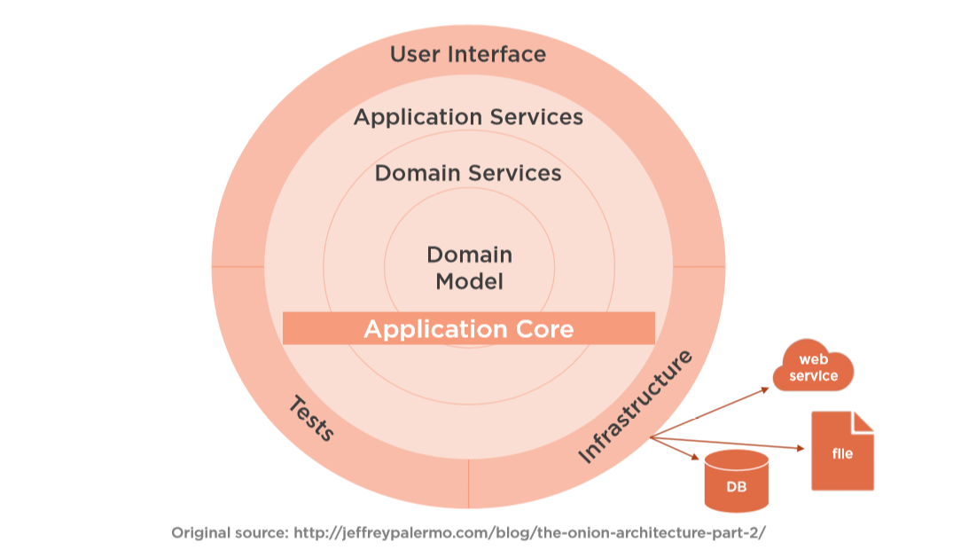
Onion Architecture

Slide 8
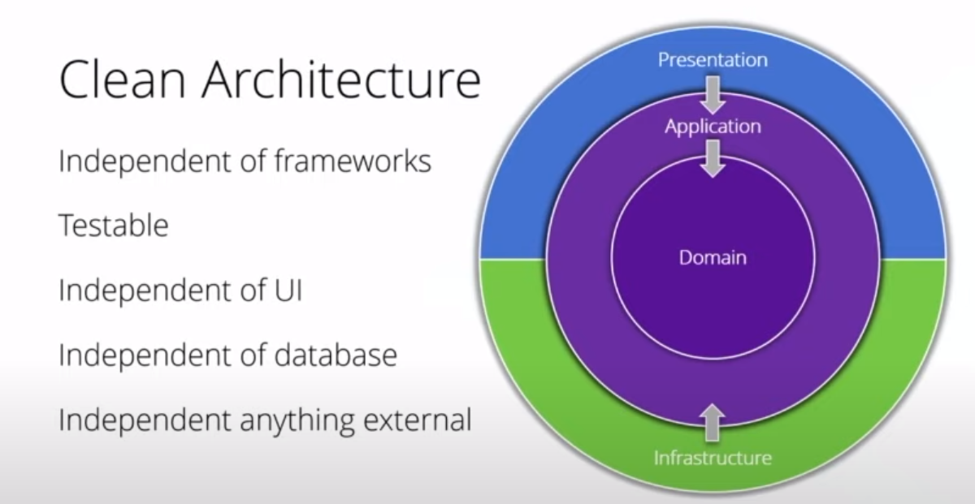
Clean Architecture

Slide 9
Common Architectures

Slide 10
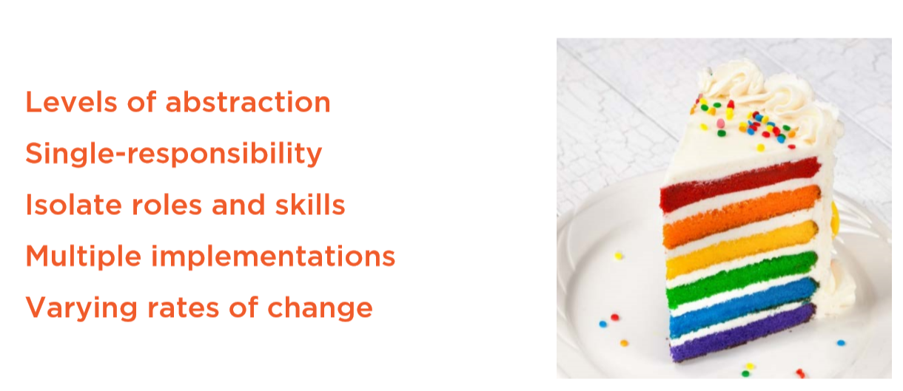
What are Layers?
Notes:
Managable units of abstraction

Slide 11
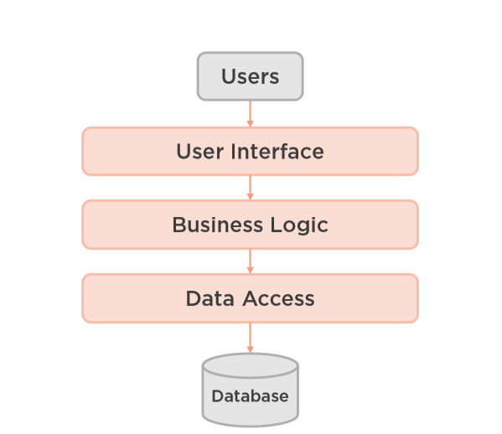
Common Tree-layer Architecture

Slide 12
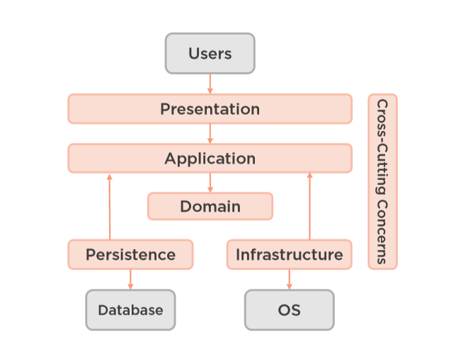
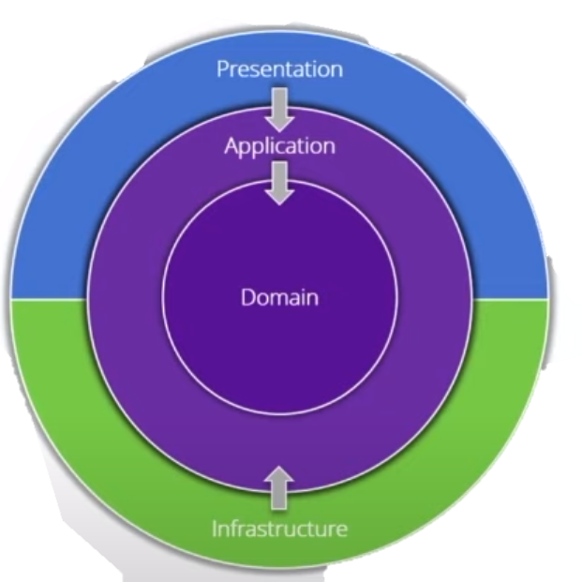
Modern Four-Layer Architecture

Slide 13
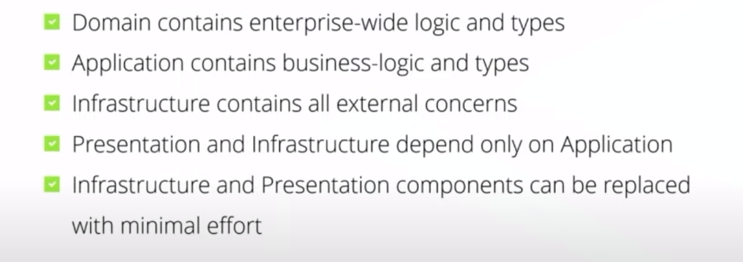
Key Points in Clean Architecture

Slide 14
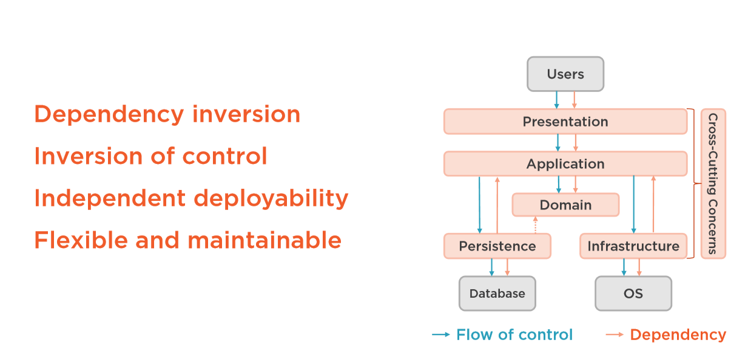
Layer dependencies

Slide 15
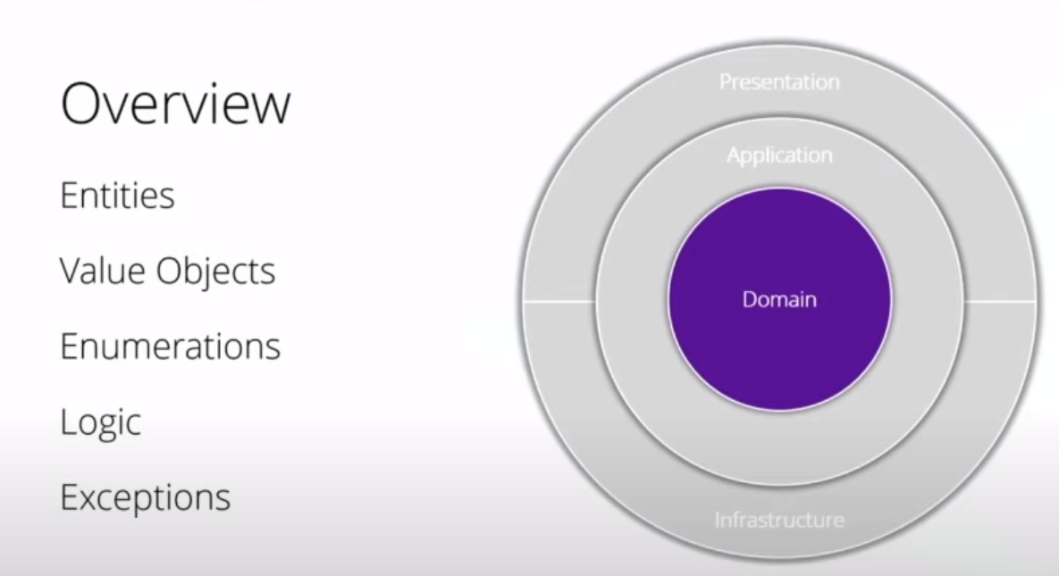

Slide 16

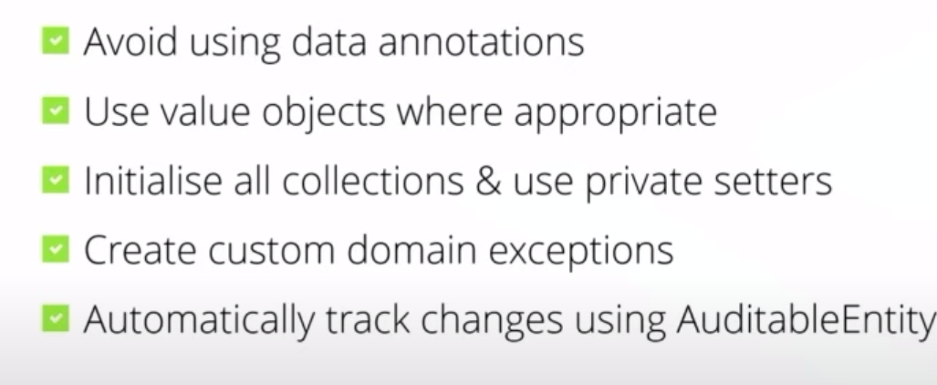
Domain Key Points

Slide 17
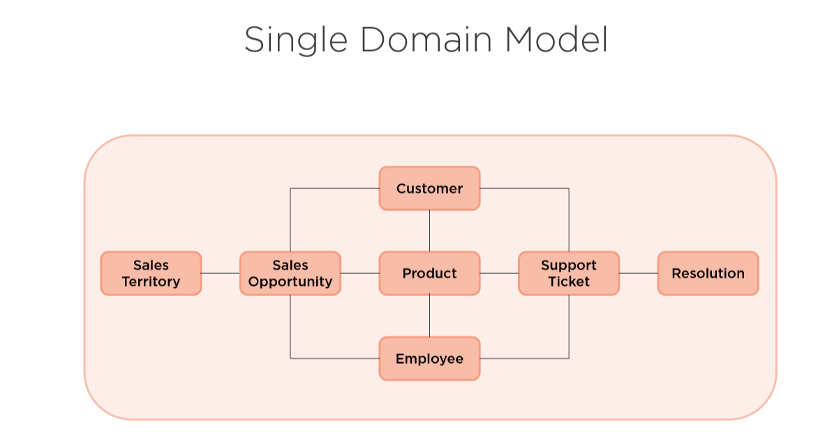

Slide 18
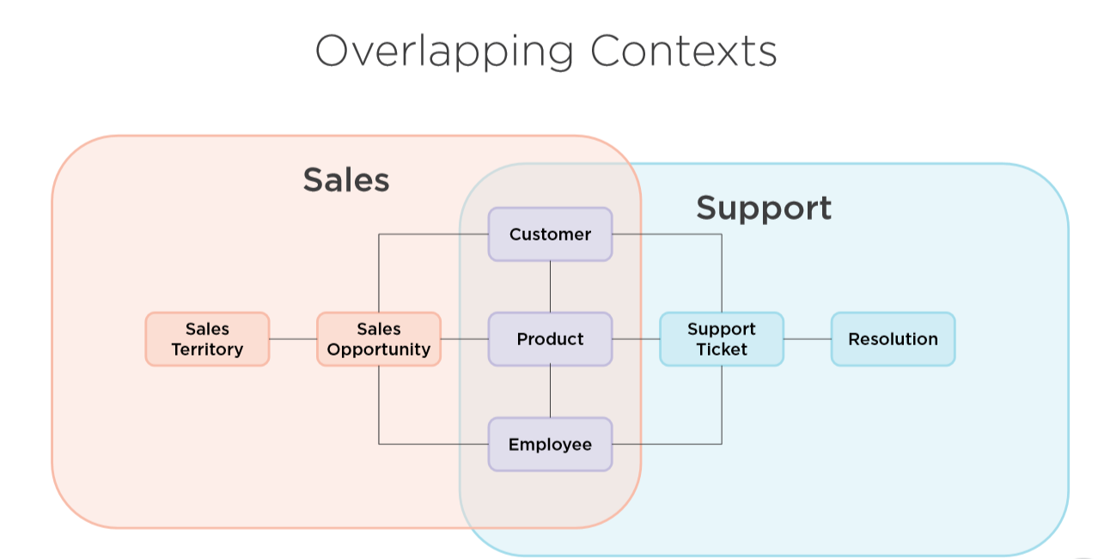

Slide 19
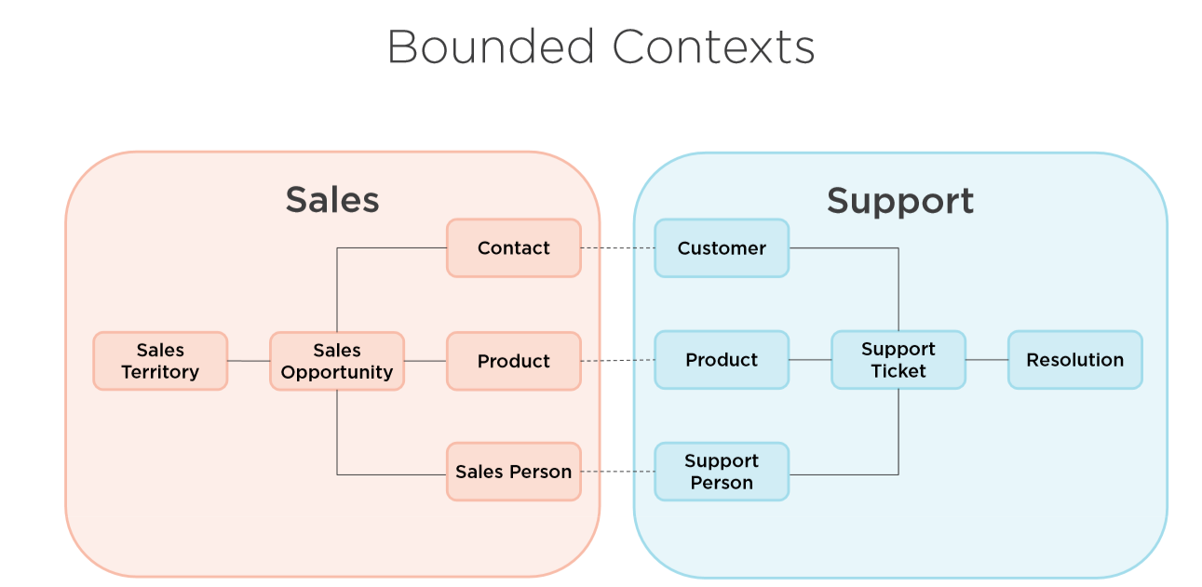

Slide 20
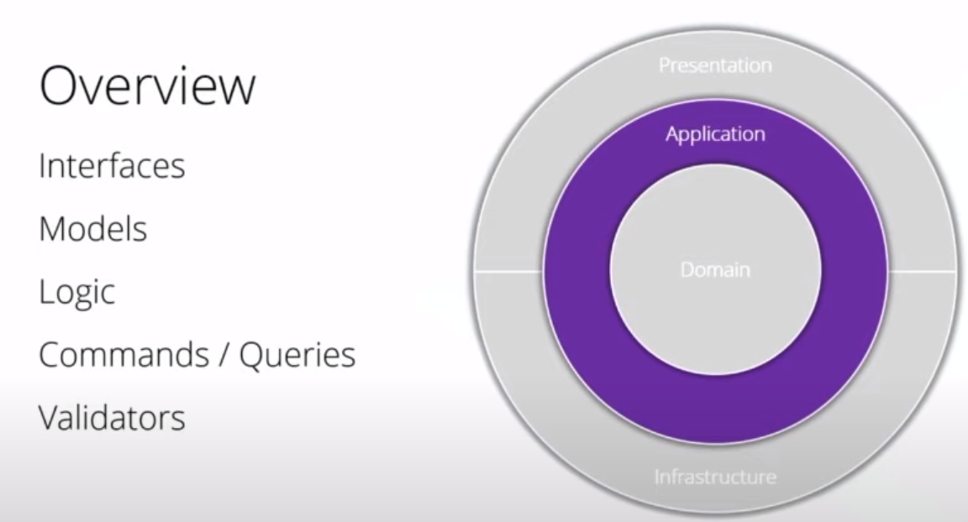

Slide 21
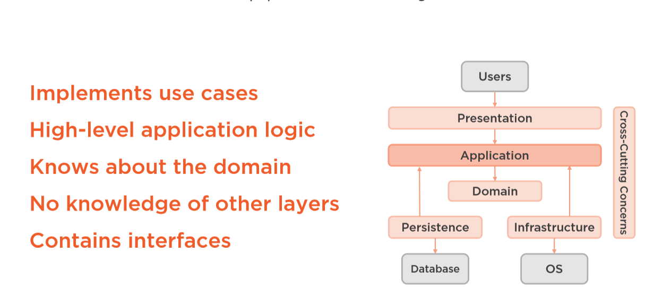
Application Layer
Notes:
Interfaces
Models
Logic
Comands/Queries
Validators

Slide 22
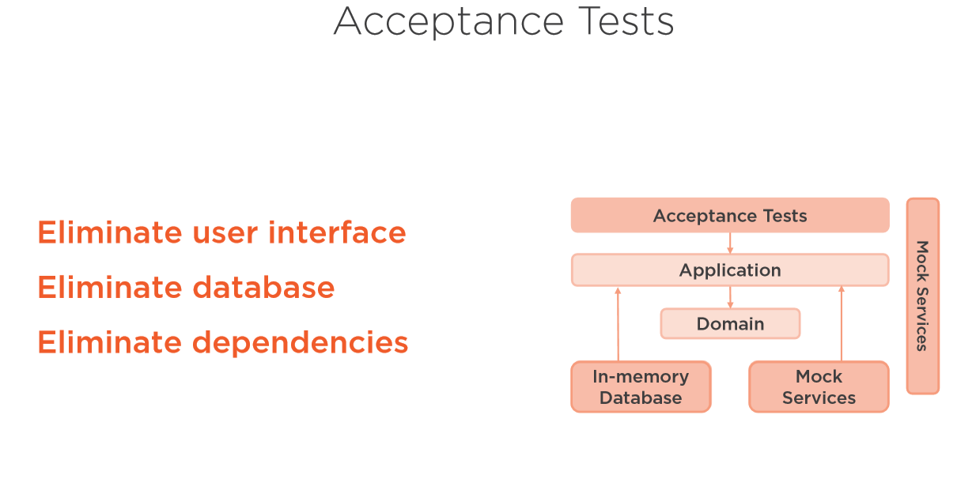

Slide 23
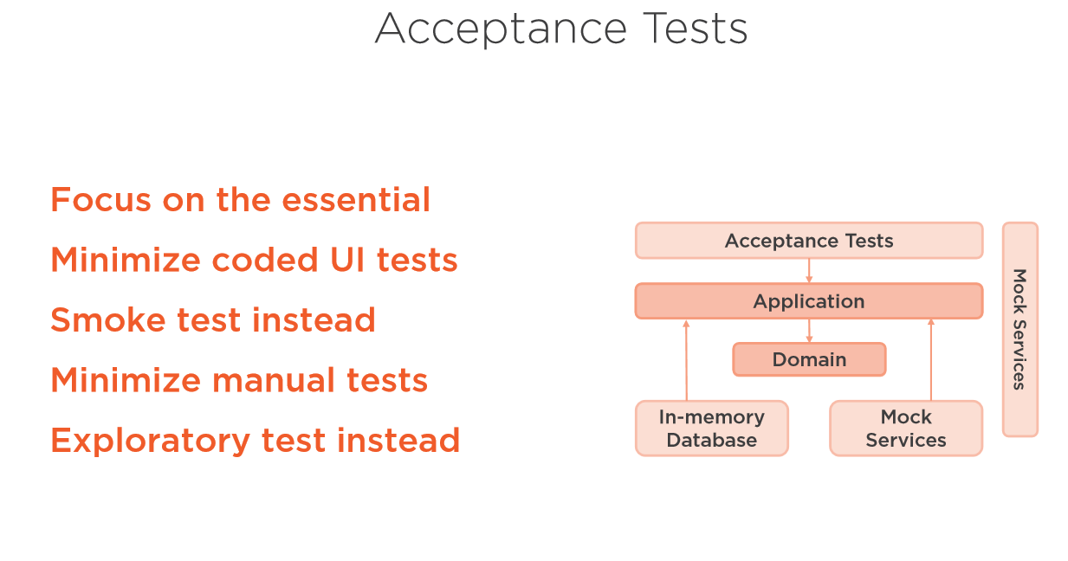

Slide 24
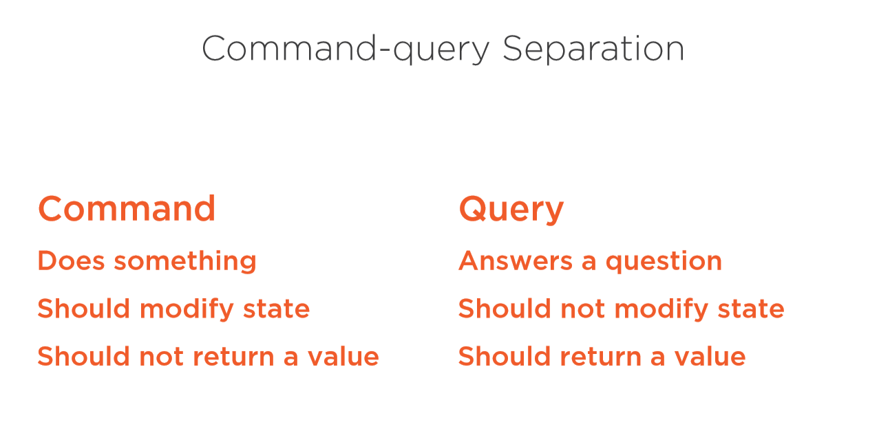

Slide 25
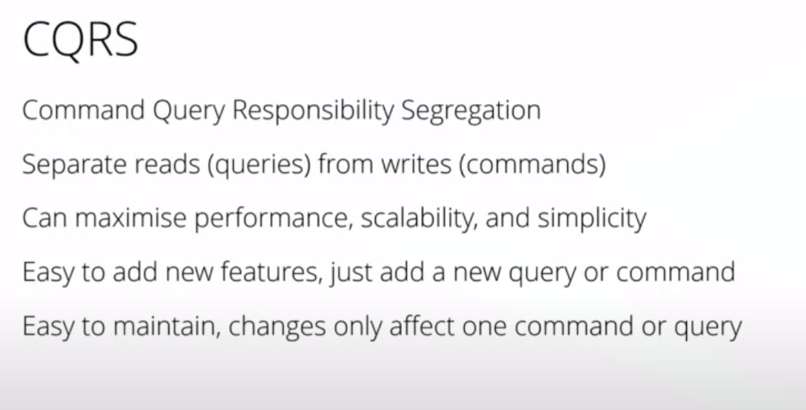

Slide 26
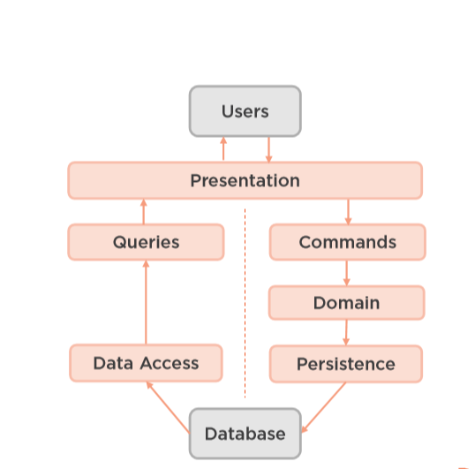
CQRS Architecture
Notes:
Jedna baza danych
Dwie bazy danych
Wiele baz danych – wiele kontekstow.
Jedne tabelki – rozne read modele

Slide 27
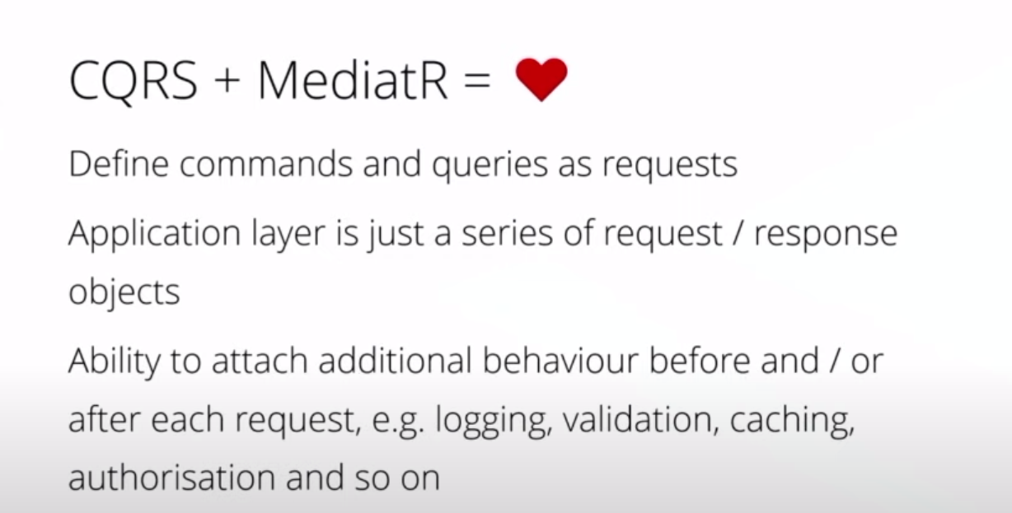

Slide 28
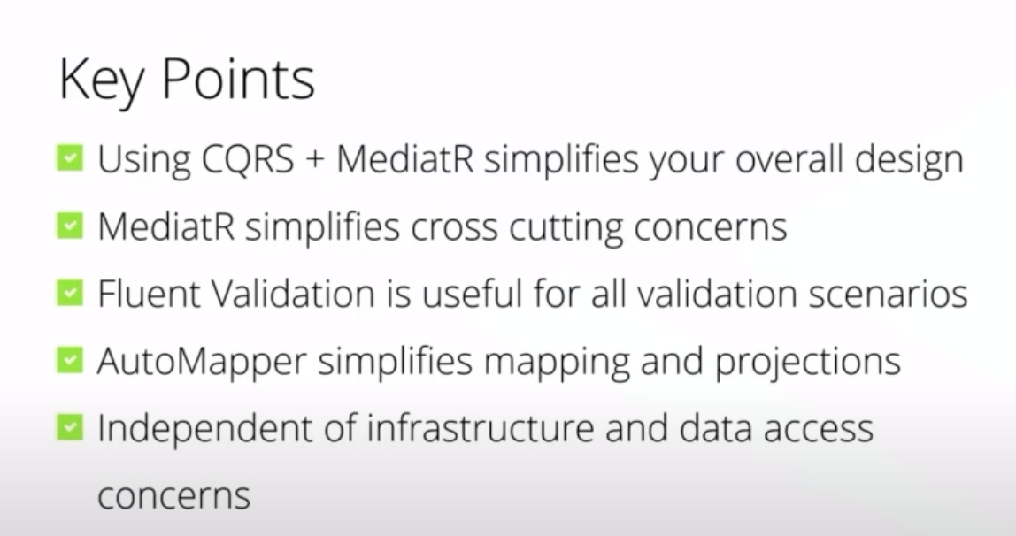

Slide 29
Radek Maziarka
https://radekmaziarka.pl/2017/08/19/cqrs-first-step-split-to-commands-and-queries/

Slide 30
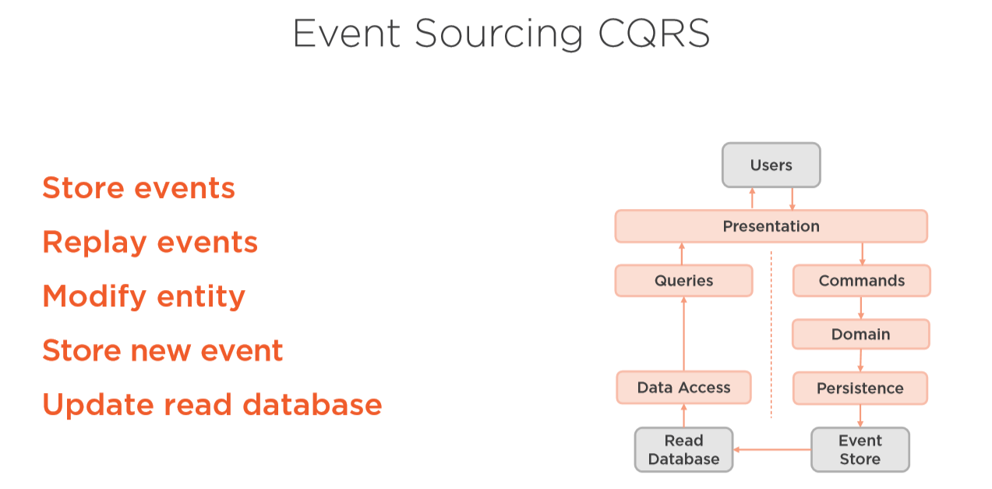
Notes:
Complete audit trail
Point in time reconstruction
Replay events
Multiple read database
Rebuild production database
Persystencja widokow

Slide 31
Oskar Dudycz
http://oskar-dudycz.pl/
https://www.szkola-event-sourcing.pl/
https://github.com/oskardudycz/EventSourcing.NetCore
DevMentors kurs w przyszłości

Slide 32
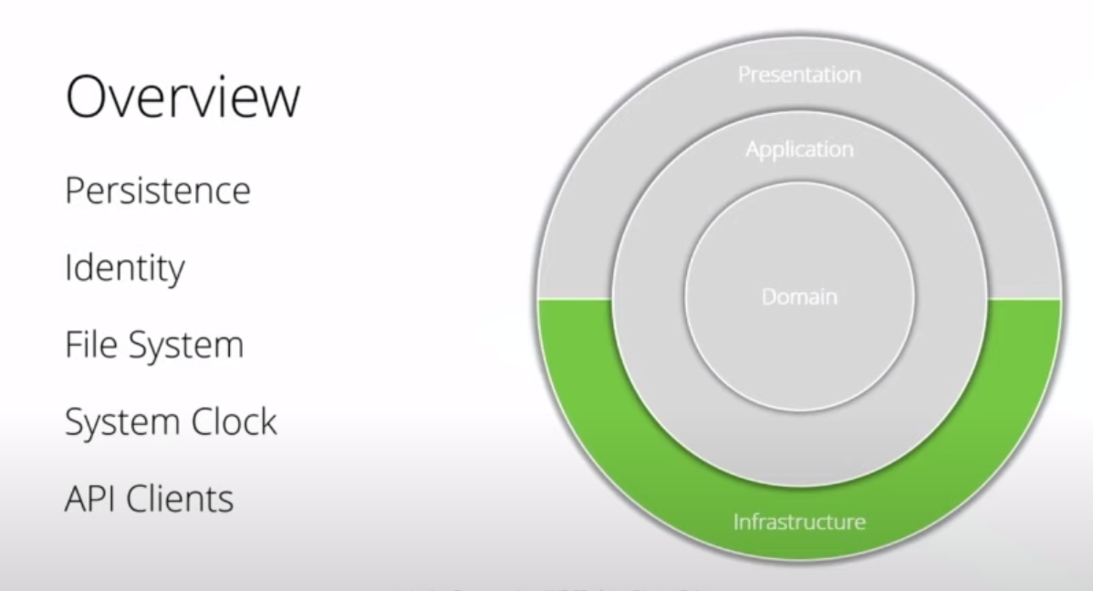
Notes:
Wszystko co zewnetrz
Może być podzielone na projekty do konkretnego zewnętrznego zrodla
Ale fajnie jak jest self containing

Slide 33
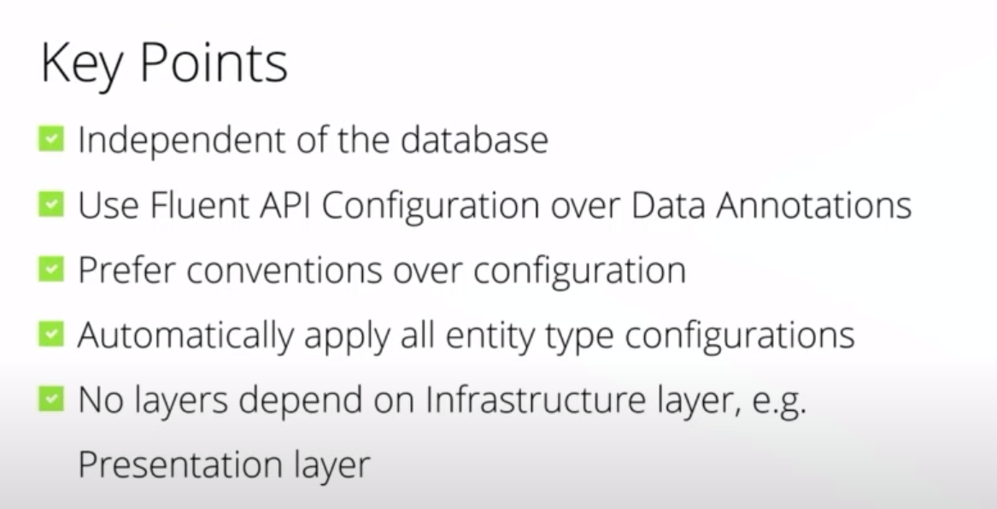

Slide 34
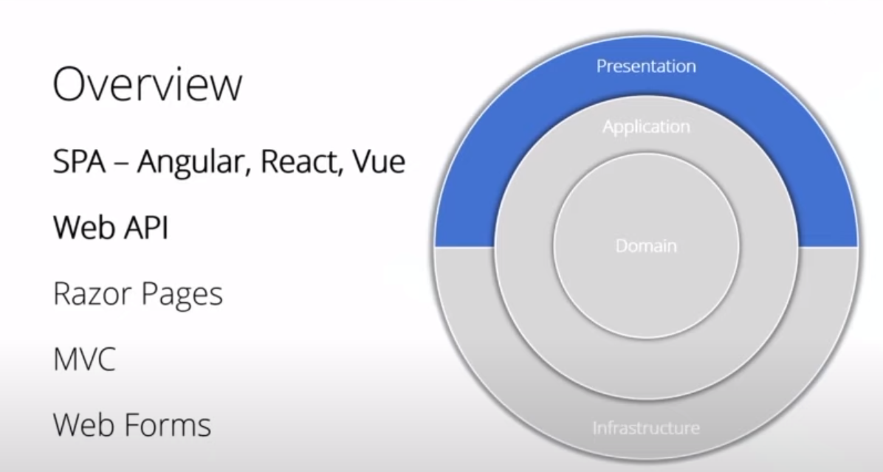

Slide 35
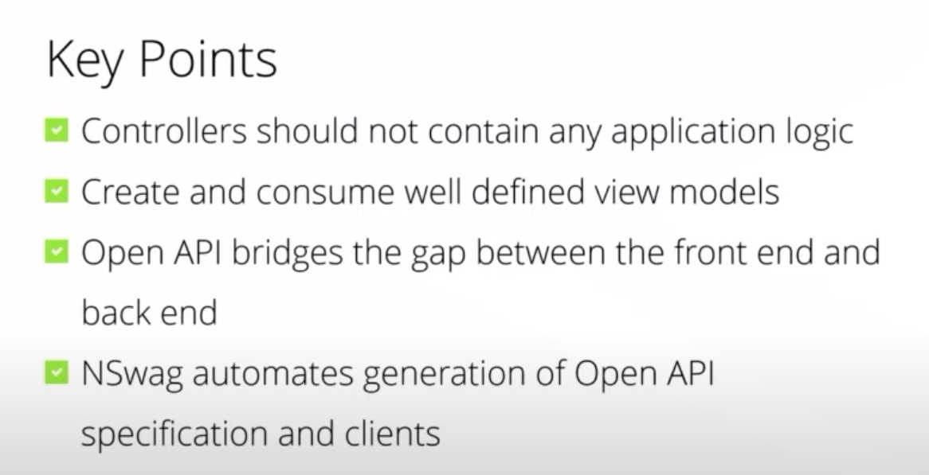

Slide 36
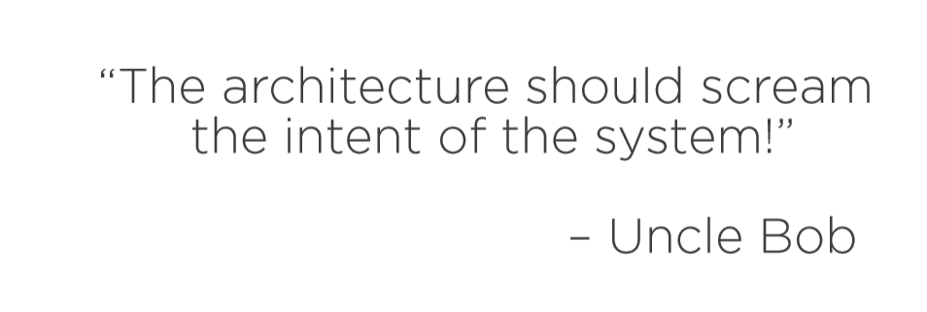
Functional Cohesion/Organization

Slide 37
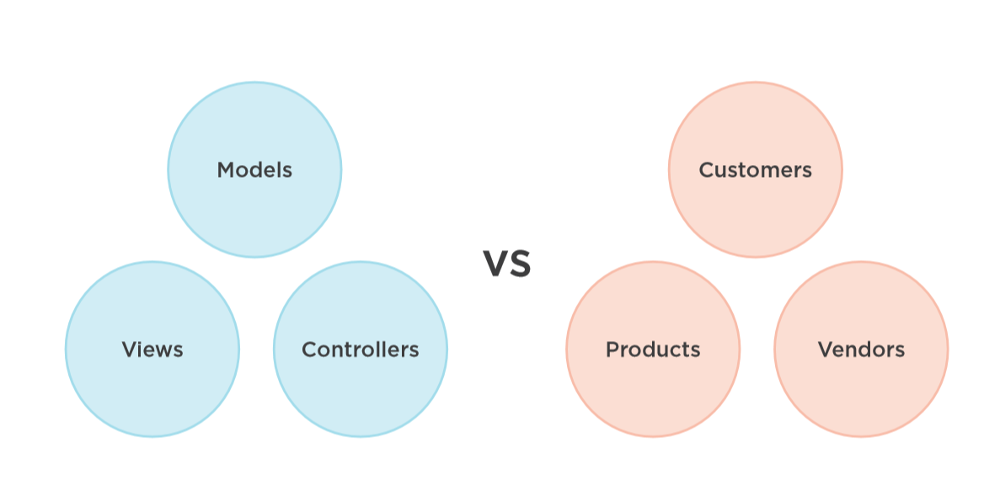

Slide 38


Slide 39
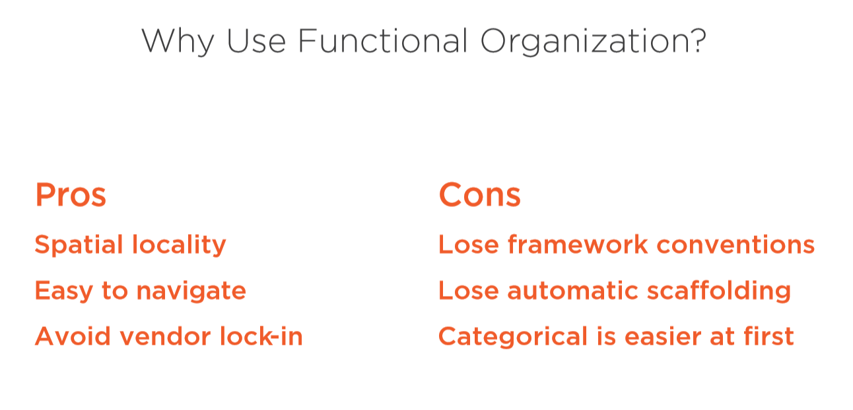

Slide 40
Modular monolith
https://www.youtube.com/watch?v=jsT2ciyaS7Q
Kamil Grzybek
https://github.com/kgrzybek/modular-monolith-with-ddd

Slide 41
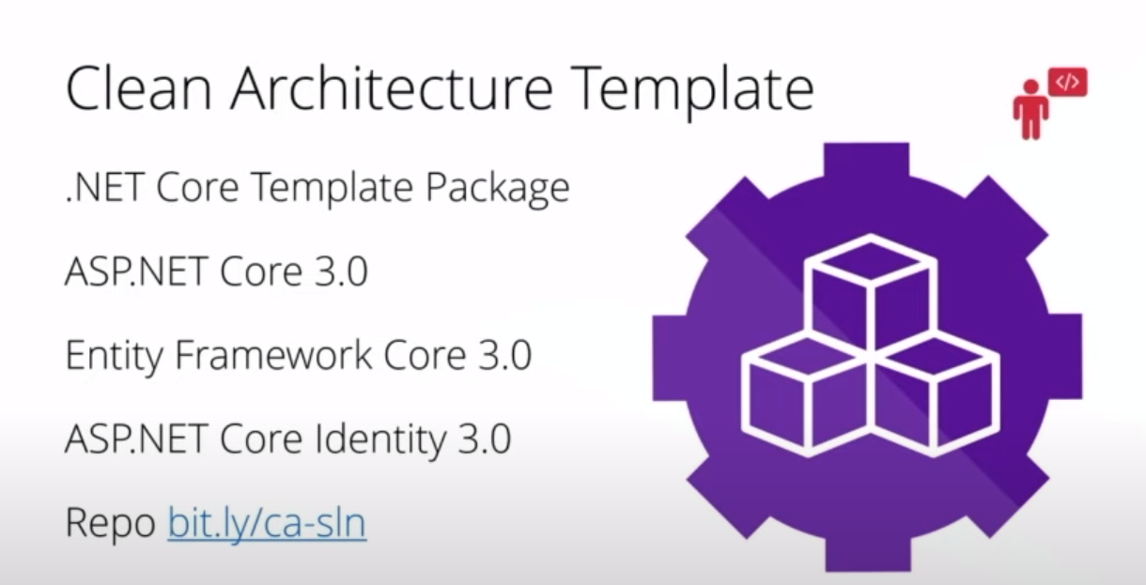

Slide 42
Thanks! Questions?

